Slide 1
Switching
Notes:
‹#›
‹#›

Slide 2
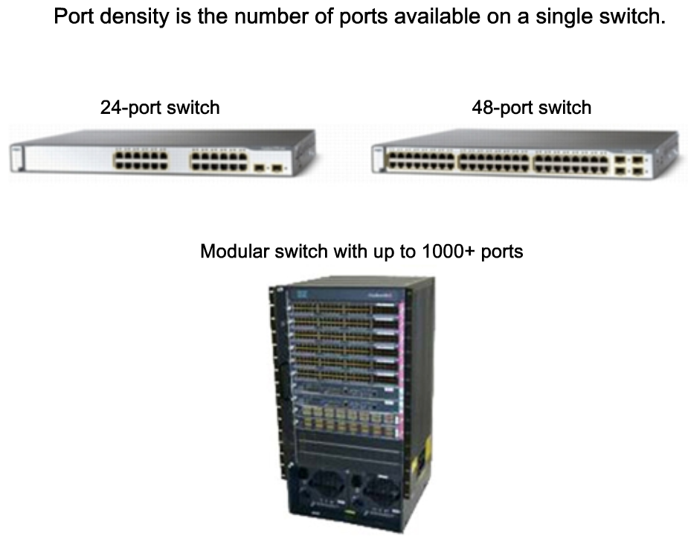
Switch type

Slide 3
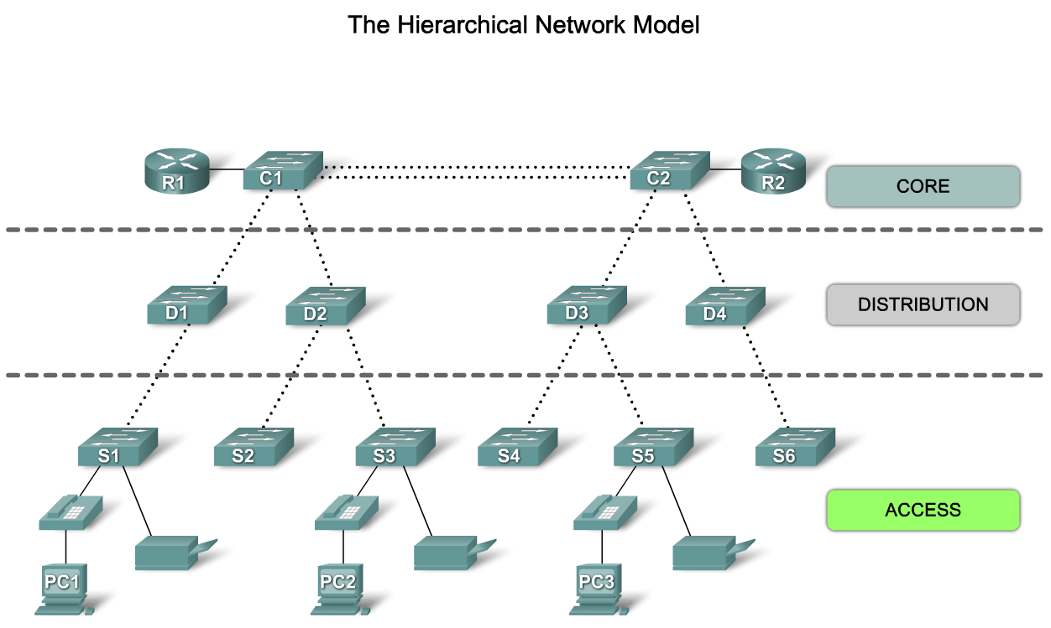
Why using Switch
To connect End Device Such as PC, IP phone and Network printer

Slide 4
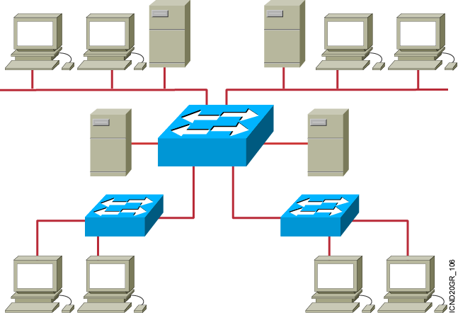
Ethernet Switches and Bridges
Transparent Bridge and Switches has 3 main functions
Address learning
Forward/filter decision
Loop avoidance
Notes:
‹#›
Emphasize: The next few slides discuss the basic function of a bridge/switch:
1. How it learns the location of the hosts by reading the source MAC address of incoming frames.
2. How it makes forwarding/filtering decisions.
There are three conditions in which a switch will flood a frame out on all ports except to the port on which the frame came in, as follows:
Unknown unicast address
Broadcast frame
Multicast frame
3. How STP is used to avoid loops in a switched/bridged network.

Slide 5
Operating Cisco IOS Software
‹#›
Notes:
‹#›
Purpose: This chapter introduces the Cisco IOS™ CLI on the Catalyst® 1900 switch and router.
Timing: This chapter should take about 2 hours to present.
Note: The Catalyst 1900 switch only has a subset of the router Cisco IOS commands available.
Contents:
Introduction to Cisco IOS. Explain to the student what is IOS?
Cisco Device startup procedures in general.
IOS configuration source.
General introduction to the IOS CLI.
Cat 1900 switch startup procedures.
Intro to Cat 1900 CLI. This part covers the basic configuration on the switch, like setting the IP address and hostname. More details about the various Cat 1900 switch configuration commands are explained in Chapter 6 and 7.
Router startup procedures. More details on the router startup process is discussed in chapter 5.
Router IOS CLI.

Slide 6
Cisco Software components
Cisco IOS (Internetwork Operating System)
It is the operating system that manages the hardware
platform it is working on.
Configuration File
It is a program file that contains commands that
reflect how the router will react.

Slide 7
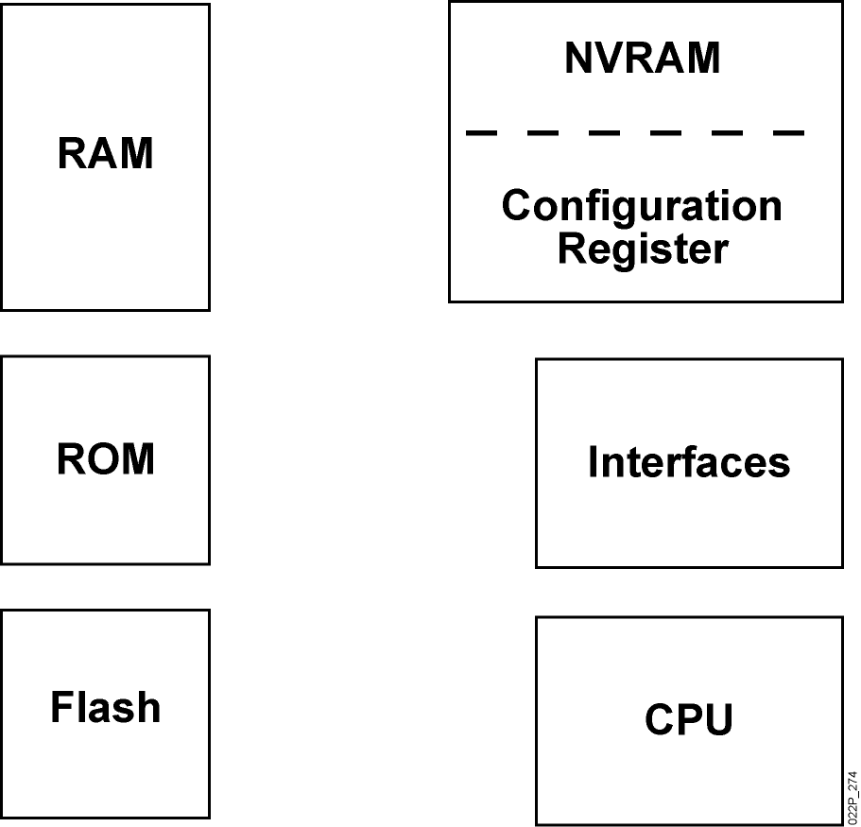
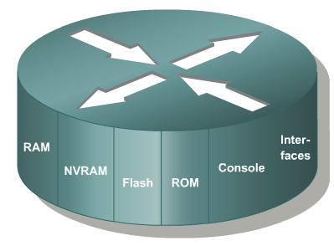
Router Internal Components
Notes:
‹#›
Note:
RAM—Packet buffers, running configurations, running Cisco IOS
ROM—POST, ROM monitor, baby Cisco IOS (Rxboot)
NVRAM—Backup configurations, config register
Flash—Cisco IOS
Flash memory is nonvolatile. It behaves like a file system. It is more expensive than NVRAM. It is readable and writeable. The 2500 routers run from Flash. If it is running Cisco IOS from Flash, then the Flash is in the readable state. Use the boot system command to boot Cisco IOS from a TFTP server so the 2500 can run from RAM if you need to write or erase Flash online.

Slide 8
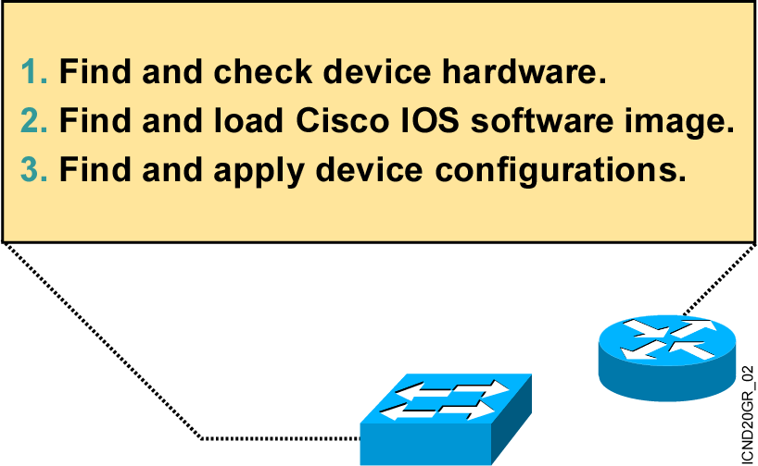
An Overview of Cisco Device Startup
Notes:
‹#›
Purpose: This slide introduces the startup process on Cisco routers and switches.
Emphasize: Paraphrase or restate the three points and make sure your students follow the description. This description is necessary to keep a common perspective of what is occurring on the switch and the router; these three steps should be an anchor to return to as needed.
Transition: Where are the sources for configuration software?

Slide 9
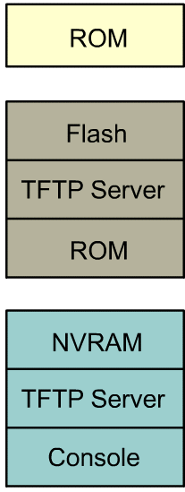
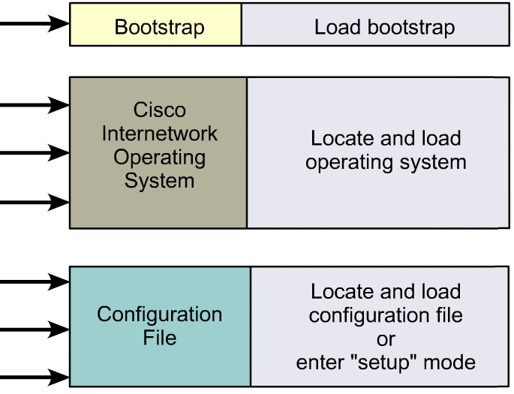
Step in Router Initialization

Slide 10
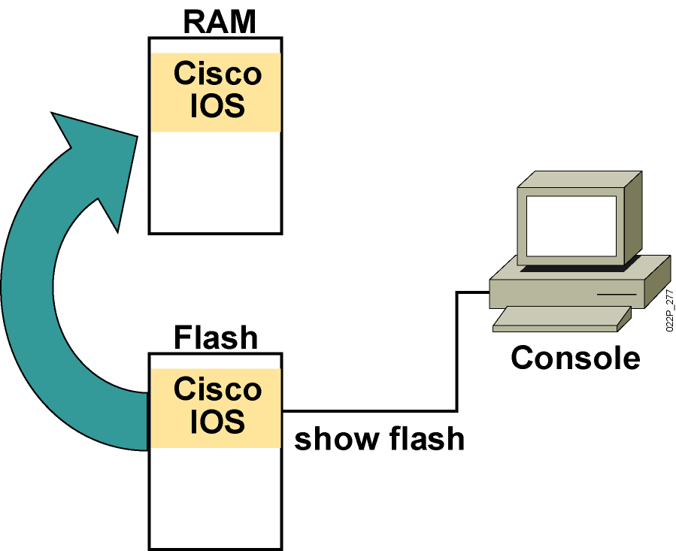
Loading the Cisco IOS Image from Flash Memory
The flash memory file is decompressed into RAM.
Notes:
‹#›
Note: The 2500 series routers do not operate this way. The 2500 series routers normally run Cisco IOS from Flash. The Cisco IOS in Flash is not compressed but it is relocatable. Relocatable means the Cisco IOS image can be run from Flash or from RAM.
The 2500 can run from RAM if you use the boot system tftp command to boot the Cisco IOS image.
The Rxboot mode is also run from RAM on the 2500 routers.

Slide 11
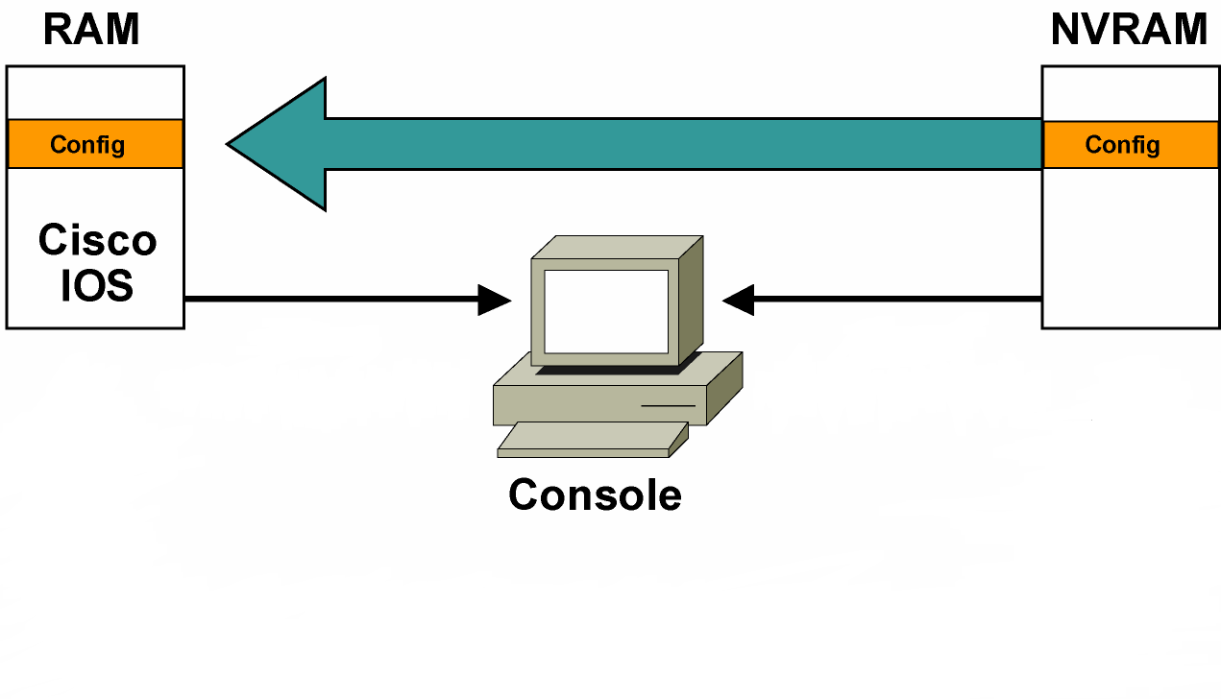
Loading the Configuration
Load and execute the configuration from NVRAM.
Notes:
‹#›
Emphasize: Using the default config register value (0x2102), the router will load the config from NVRAM at startup.

Slide 12
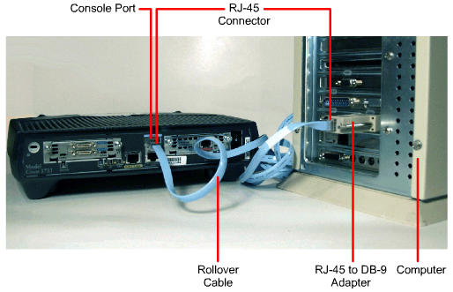
Computer/Terminal Console Connection

Slide 13
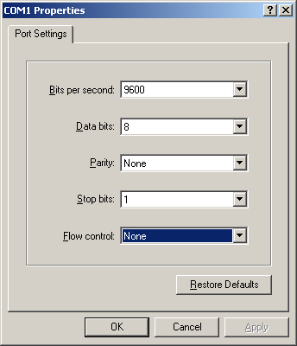
HyperTerminal Session Properties

Slide 14
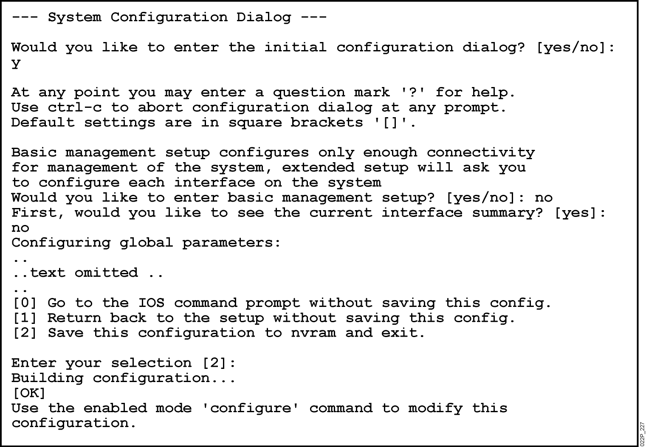
Setup mode
- Permit the administrator to install a minimal configuration for a router ( appeared if no saved configuration , Ctrl-C to skip )
Notes:
‹#›
Purpose: This slide describes the console output on the Catalyst 1900 switch during startup.
Emphasize: If a POST fails, a corresponding console message will be displayed indicating the POST failure. In this slide, the switch started up without any POST error.
From the User Interface menu, select K to access the command-line interface.
In this class, we will only discuss the Catalyst 1900 CLI configuration method.

Slide 15
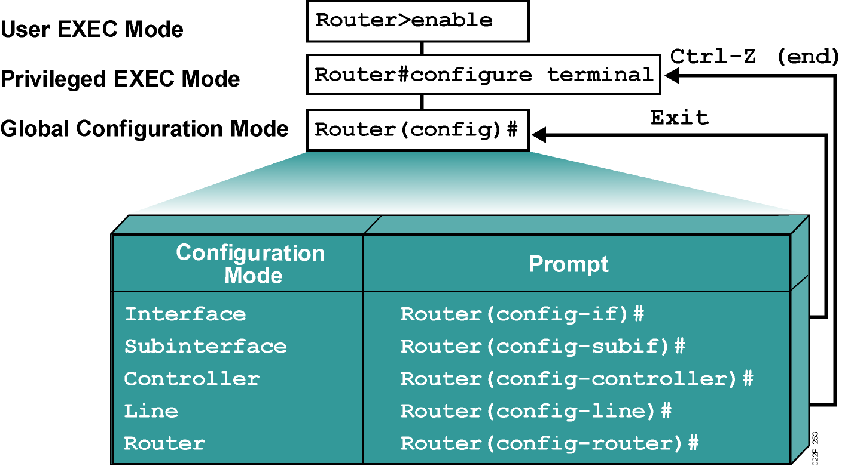
Other Router Modes
Notes:
‹#›
Emphasize: Here is a list of some of the configuration modes available.
For a complete list of the router configuration modes, refer to the Cisco Documentation CD-ROM.

Slide 16
IOS Features
Support context help and abbreviations ( ? )
Support of auto complete ( Tab button )
Support syntax error detection

Slide 17
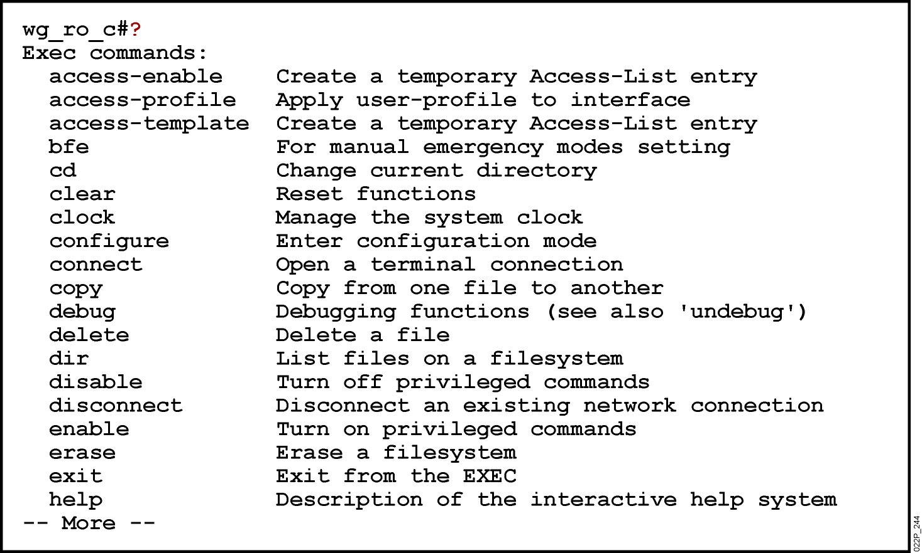
Context help features

Slide 18
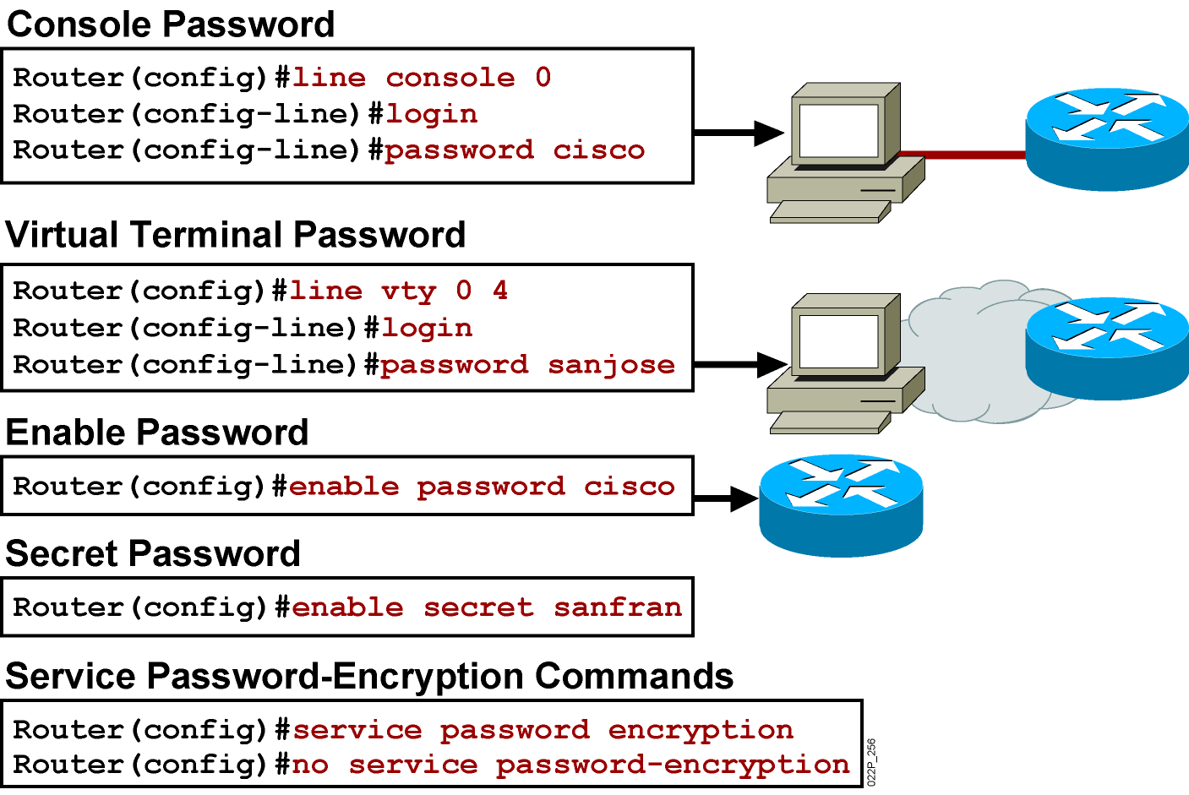
Configuring a Router Password
Notes:
‹#›
Layer 2 of 2
Emphasize: The router has one enable password. Remember that this is your only protection. Whoever owns this password can do anything with the router, so be careful about communicating this password to others. To provide an additional layer of security, particularly for passwords that cross the network or are stored on a TFTP server, you can use either the enable password or enable secret commands. Both commands accomplish the same thing; that is, they allow you to establish an encrypted password that users must enter to access enable mode (the default), or any privilege level you specify. Cisco recommends that you use the enable secret command because it uses an improved encryption algorithm. Use the enable password command only if you boot an older image of the Cisco IOS software, or if you boot older boot ROMs that do not recognize the enable secret command. If you configure the enable secret password, it is used instead of the enable password, not in addition to it.
Cisco supports password encryption. Turn on password encryption using the service password-encryption command. Then enter the desired passwords for encryption. Immediately, on the next line, enter the no service password-encryption command. Only those passwords that are set between the two commands will be encrypted. If you enter service password-encryption and then press Ctrl-Z to exit, all passwords will be encrypted.
Note: Password recovery is not covered in the course materials. Refer the students to the IMCR class.

Slide 19
monitoring and debugging
show commands are typed in both privileged EXEC and user EXEC modes
#show interfaces – Displays all the statistics for all the interfaces
#show int F0/1 – Displays statistics for interface Serial 0/1
#show ip interface brief – Displays a summary about interfaces
#show flash – Displays info about flash memory and what IOS in it
#show start – Displays the saved configuration located in NVRAM
#show run – Displays the configuration currently running in RAM
#show version – Displays info about the router and the IOS
#show ARP – Displays the ARP table of the router
#show protocol – Displays the global and interface specific status of any
configured Layer 3 protocols
#erase nvram – erase the saved configuration file
#reload – restart the router
#copy run start – save the current configuration in RAM into the NVRAM

Slide 20
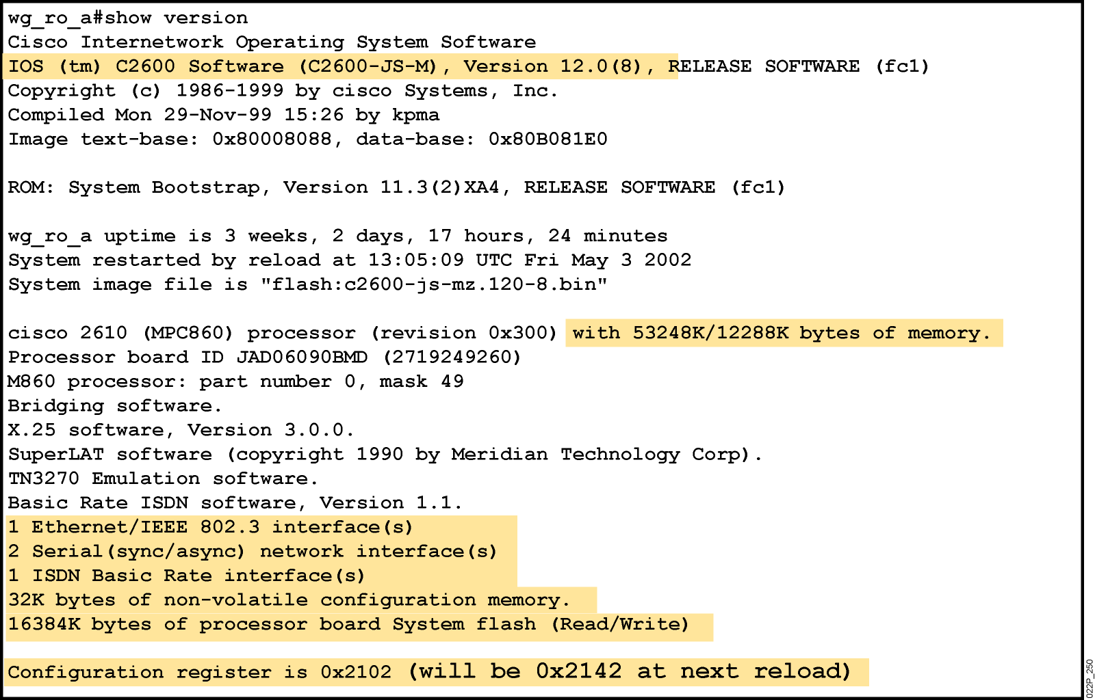
show version Command
Notes:
‹#›
Purpose: This slide presents the show version command.
Emphasize: Point out that this command is useful when troubleshooting problems because it gives the versions of the various software components and files. It also displays how long the router has been in operation and where it obtained the image file.
Config register is discussed in Chapter 6, “Catalyst Switch Operations.”

Slide 21
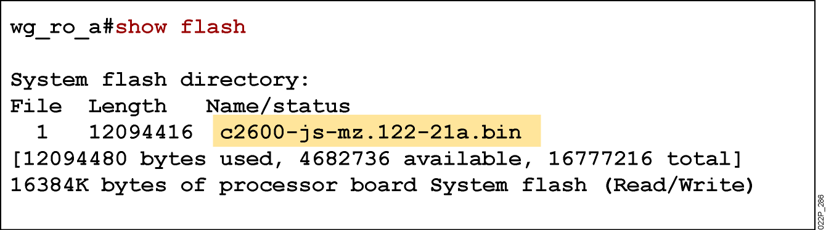
show flash command
Notes:
‹#›
Emphasize: The show flash command is an important tool to use to gather information about your router memory and image file. Caution students that they must know that they are loading the correct and appropriate image. The name for the Cisco IOS image file contains multiple parts, each with a specific meaning:
The first part of the image name contains the platform on which the image runs. In this example, the platform is C2500.
The second part of the name identifies the special capabilities of the image file. A letter or series of letters identifies the feature sets supported in that image. In this example, the “j” indicates this is an enterprise image, and the “s” indicates it contains extended capabilities.
The third part of the name specifies where the image runs and if the file is compressed. In this example, “l” indicates the file is relocatable and not compressed. Relocatable means the Cisco IOS can be run from Flash or from RAM. You should be careful in reading the Cisco IOS image filename. Some fonts display the lowercase letter “l” and the number 1 as the same character. How you enter the characters will impact the ability of the router to load the files correctly.
The fourth part of the name indicates the version number. In this example, the version number is 12.0 (3).
The final part of the name is the file extension. The .bin extension indicates this file is a binary executable file.
The Cisco IOS software naming conventions, name part field meaning, image content, and other details are subject to change. Refer to Cisco Connection Online (CCO) for updated details.

Slide 22
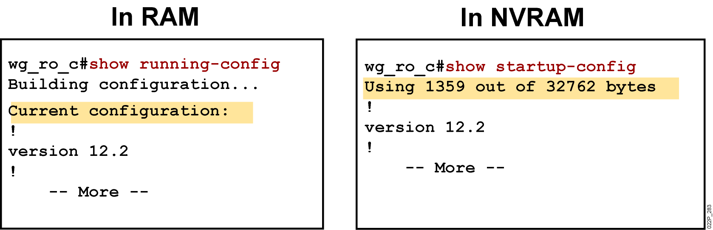
show running-config and show startup-config Commands
Displays the current and saved configuration
Notes:
‹#›
Purpose: This slide is a repeated slide from Chapter 4, “Operating and Configuring a Cisco IOS Device.”

Slide 23
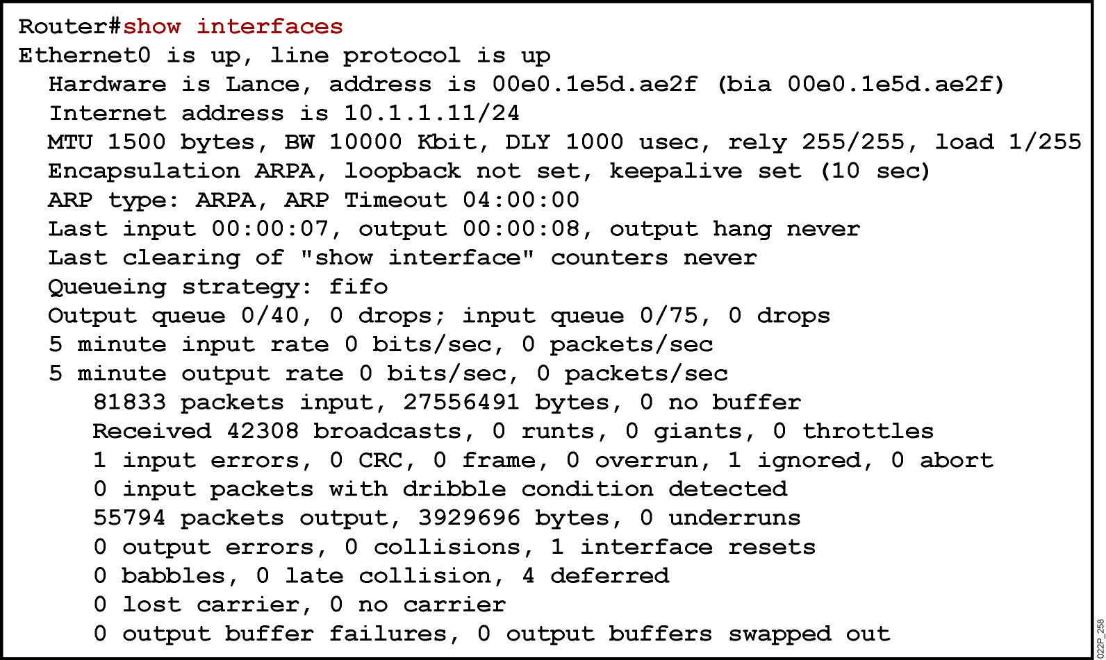
show interfaces Command
Notes:
‹#›
Purpose: This slide presents the show interfaces command, which indicates whether the network is operating at the physical and data link layers. The command output is interpreted later in this chapter.
Emphasize: The top line of the output tells us that the line is up. A few lines down, the output provides the IP address, and below that some characteristics like BW for bandwidth, and DLY for delay. On the next line down, we find an encapsulation type of ARPA. ARPA means Ethernet II, which is the default IP encapsulation type for Ethernet interfaces on Cisco routers.
A runt is an Ethernet frame that is too small to be legal (less than 64 bytes), and a giant is an Ethernet frame that is too big (greater than 1518 bytes).

Slide 24
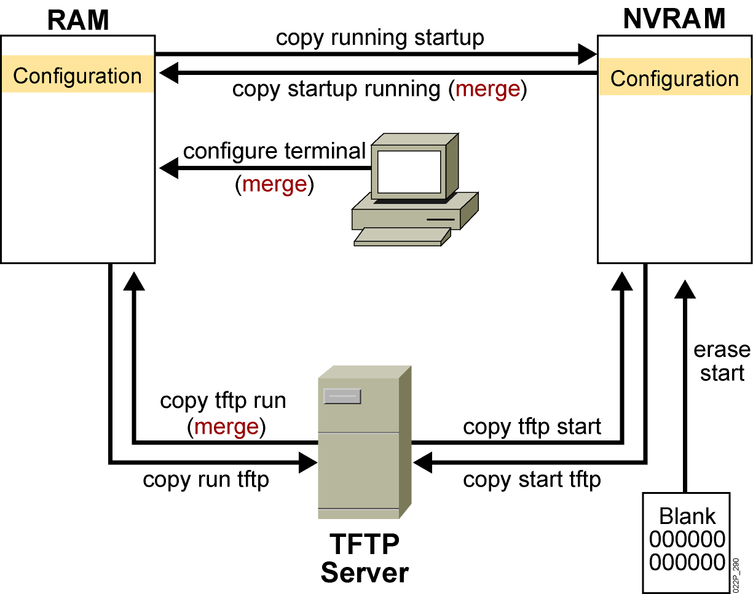
Cisco IOS copy Command
To save IOS image or configuration file
#
#
#
#
#
#
Notes:
‹#›
Layer 4 of 4

Slide 25
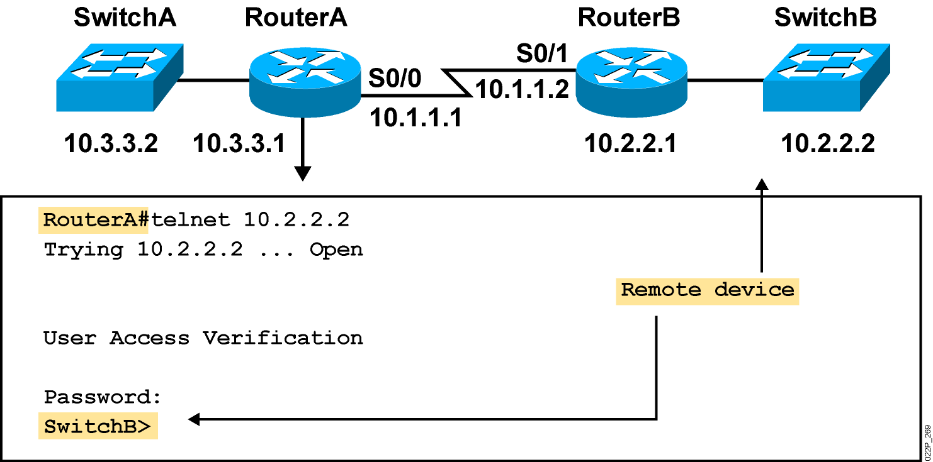
Using Telnet to Connect to Remote Devices
Telnet is used to check all the TCP/IP stack
Notes:
‹#›
Emphasize: Another way to learn about a remote device is to connect to it. Telnet, a virtual terminal protocol that is part of the TCP/IP protocol suite, allows connections to remote hosts. By default, a router can have up to five simultaneous incoming Telnet sessions. With Cisco’s implementation of TCP/IP, you need not enter the connect or telnet command to establish a Telnet connection. If you prefer, you can just enter the learned host name, and the router will resolve the host name using DNS or a local host table. To end a Telnet session, use the exit or logout EXEC command.
These are alternate commands for the operations listed on the graphic:
Initiate a session:
Denver> connect paris
Denver> paris
Denver> 131.108.100.152
Resume a session (enter session number or name):
Denver> 1
Paris>
End a session:
Paris> exit
Note: The Catalyst 1900 can accept incoming Telnet connections but cannot initiate an outgoing Telnet session.

Slide 26
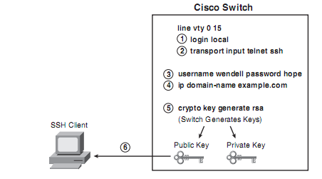
Using SSH (secure shell)
SSH used instead of Telnet because SSH send data encrypted

Slide 27
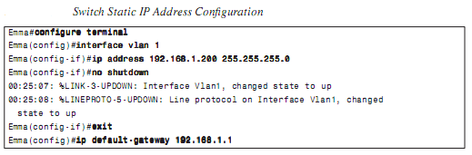
IP address For Switch

Slide 28
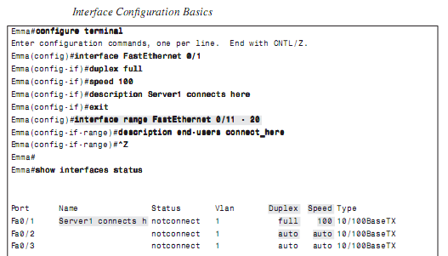
Configure switch interfaces

Slide 29
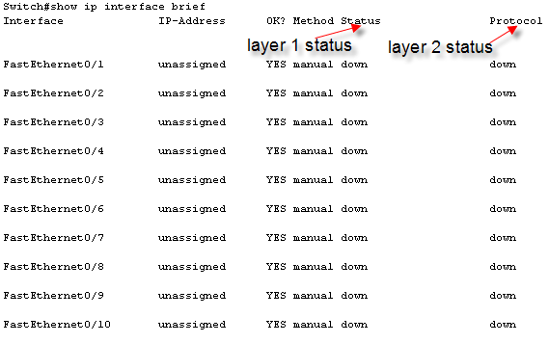
Show interface status

Slide 30
Managing the MAC Address Table
wg_sw_2950#show mac-address-table
Mac Address Table
-------------------------------------------
Vlan Mac Address Type Ports
---- ----------- -------- -----
All 0008.a445.9b40 STATIC CPU
All 0100.0ccc.cccc STATIC CPU
All 0100.0ccc.cccd STATIC CPU
All 0100.0cdd.dddd STATIC CPU
1 0008.e3e8.0440 DYNAMIC Fa0/2
Total Mac Addresses for this criterion: 5
wg_sw_2950#
Notes:
‹#›
Layer 2 of 2
Note: The 1900en maximum MAC address table size is 1024. Once the table is full, it will flood all new addresses until existing entries age out.
The command to change the MAC address table aging time is as follows:
wg_sw_a(config)#mac-address-table aging-time ?
<10-1000000> Aging time value
The default is 300 sec.
The MAC address table is also referred to as the CAM table (Content Address Memory) on some switches.

Slide 31
Setting a Static MAC Address
Catalyst 2950 Series
wg_sw_2950(config)#mac-address-table static mac-addr vlan vlan-id interface interface-id
wg_sw_2950(config)# mac-address-table static 0004.5600.67ab vlan 1 interface fastethernet0/2
Notes:
‹#›
Layer 3 of 3
Emphasize: Permanent addresses do not age out.

Slide 32
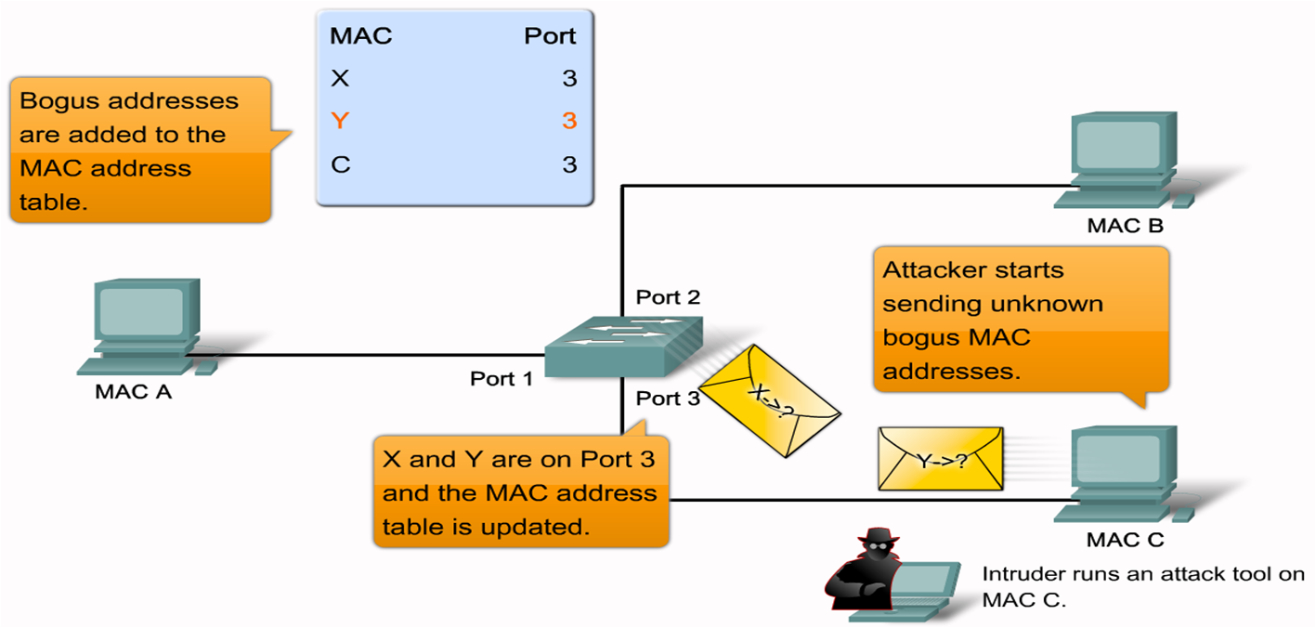
Configure Basic Security on a Switch

Slide 33
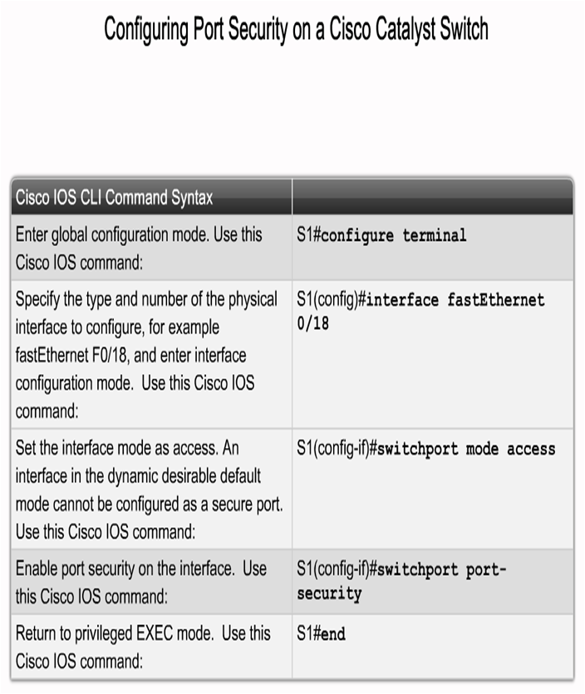
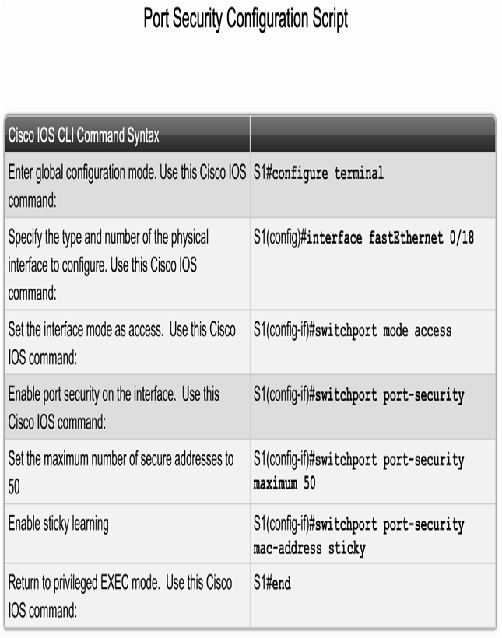
Configure port security

Slide 34
Configuring Port Security
Catalyst 2950 Series
wg_sw_2950(config-if)#switchport port-security [mac-address mac-address] | [maximum value] | [violation {protect |restrict | shutdown}]
wg_sw_2950(config)#interface fa0/1
wg_sw_2950(config-if)#switchport mode access
wg_sw_2950(config-if)#switchport port-security
wg_sw_2950(config-if)#switchport port-security maximum 1
wg_sw_2950(config-if)#switchport port-security mac-address 0008.eeee.eeee
wg_sw_2950(config-if)#switchport port-security violation shutdown
Notes:
‹#›
Layer 2 of 2
Note: When the switch-sticky learns a MAC address on a secured port, the switch will make that MAC address a permanent address.

Slide 35
Verifying Port Security on the Catalyst 2950 Series
wg_sw_2950#show port-security [interface interface-id] [address] [ | {begin | exclude | include} expression]
wg_sw_2950#show port-security interface fastethernet 0/5
Port Security : Enabled
Port Status : Secure-up
Violation Mode : Shutdown
Aging Time : 20 mins
Aging Type : Absolute
SecureStatic Address Aging : Disabled
Maximum MAC Addresses : 1
Total MAC Addresses : 1
Configured MAC Addresses : 0
Sticky MAC Addresses : 0
Last Source Address : 0000.0000.0000
Security Violation Count : 0
Notes:
‹#›
Layer 2 of 2
Emphasize: The default action is “suspend.”

